Slide 1
The Million Dollar Question
Does Major League Baseball Payroll Contribute to Wins?
Trent Leslie, 2021, Technical Audience

Slide 2
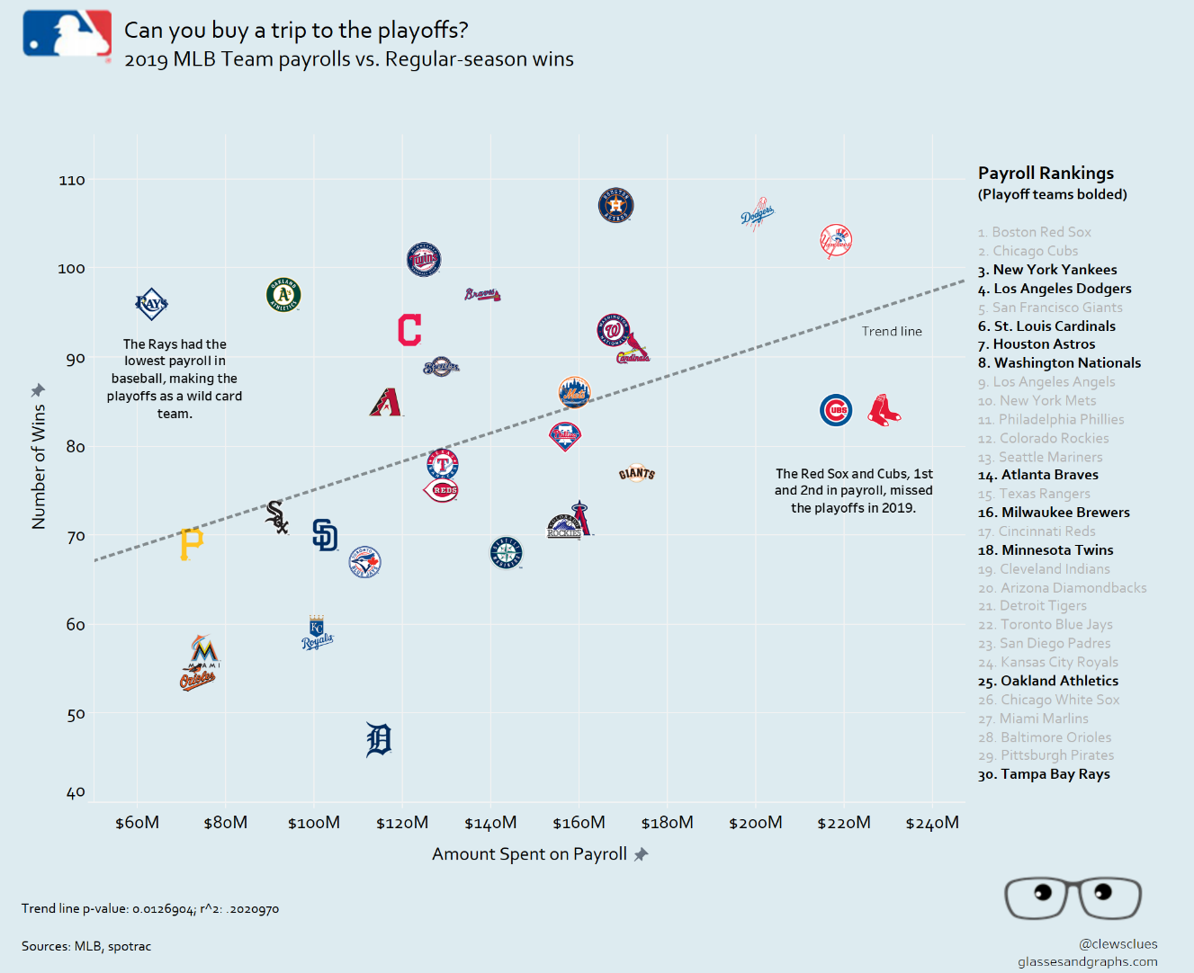
On Deck
In honor of the World Series, let’s revisit the age-old question of how payroll impacts a team’s success in Major League Baseball
Payroll often introduces a David & Goliath dynamic in baseball, particularly during the postseason
So, do small market teams have any chance at reaching the postseason like the Tampa Bay Rays in 2019?

Slide 3

The Data
Kaggle Baseball Databank
www.kaggle.com/open-source-sports/baseball-databank
Teams Data (1985-2015)
888 rows
49 columns (31 int, 4 float, 14 categorical)
Payroll Data (1985-2015)
25,575 rows
6 columns (2 int, 4 categorical)

Slide 4
The Data
Kaggle Baseball Databank data of interest
Teams Data (1985-2015)
Wins
Hitting & Fielding Stats
Payroll Data (1985-2015)
Player salaries

Slide 5

The Data
Data Normalization
All salaries adjusted for inflation for each respective year to 2021 dollars
Log transformation performed on all data to account for non-normal distributions
Outliers (>3 STDs) removed

Slide 6
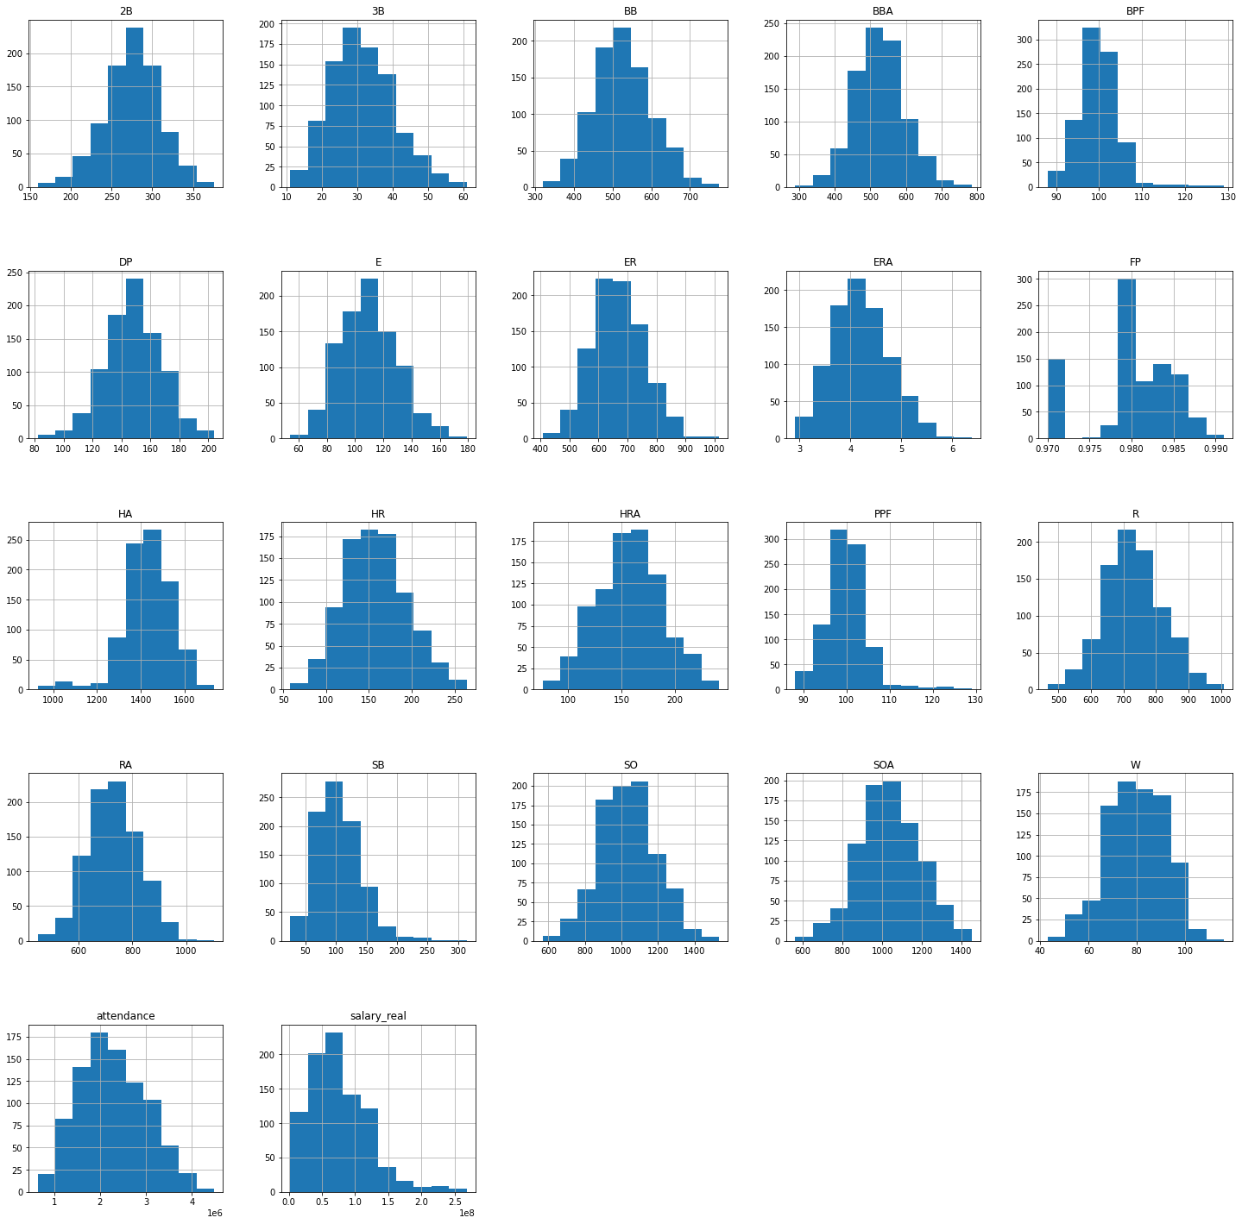
The Non-Normalized Data

Slide 7
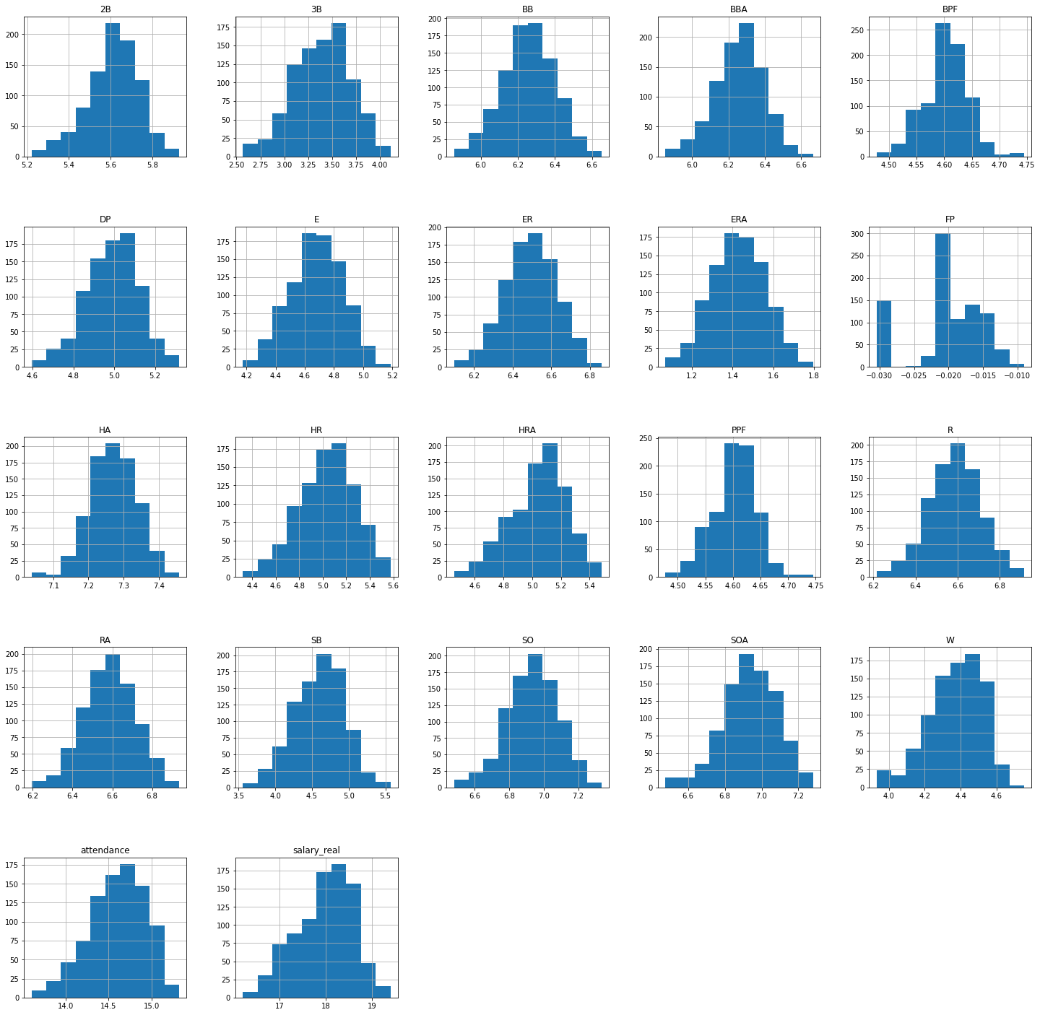
The Normalized Data

Slide 8
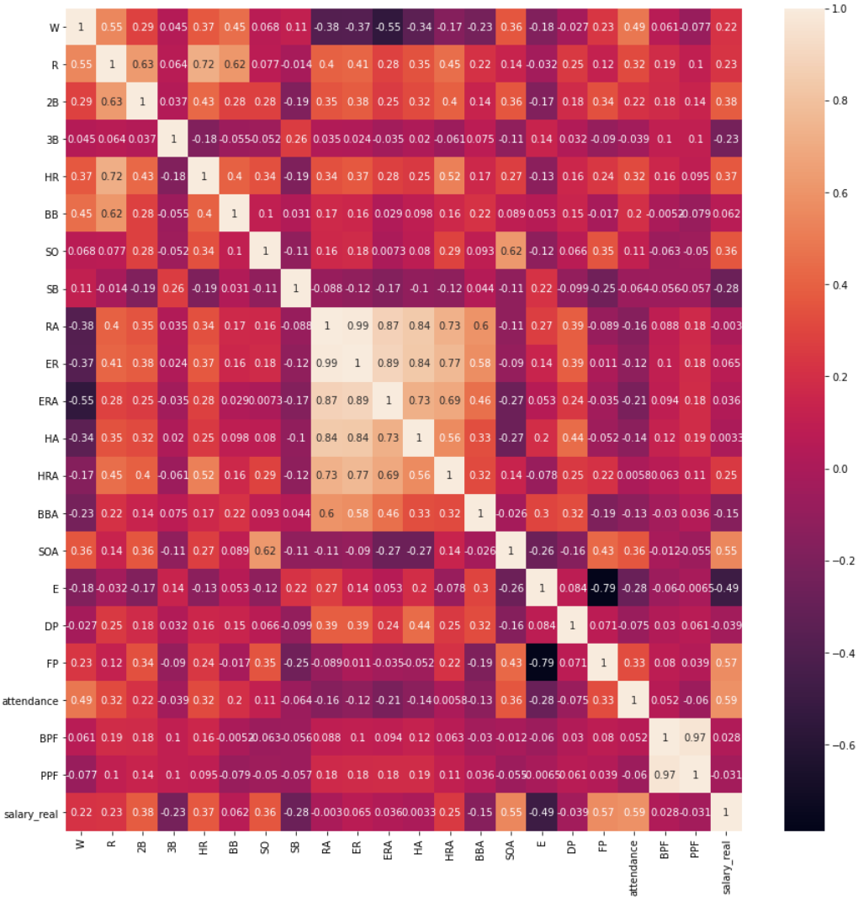
The Correlations
Bottom Row: Salary
Attendance (+)
Fielding % (+)
Strikeouts Allowed (+)
Left Column: Wins
Runs (+)
Earned Run Average (-)
Attendance (+)
Salary & Win Correlation
0.22, not a great correlation

Slide 9
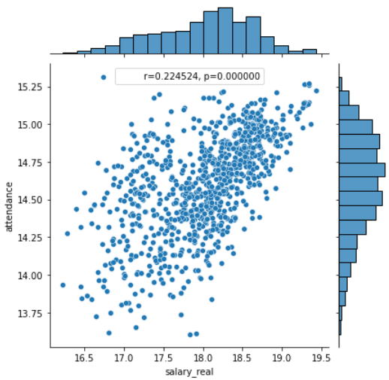
The Attendance vs. Salary Linear Regression
An interesting correlation
Does the salary drive attendance or the other way around?

Slide 10
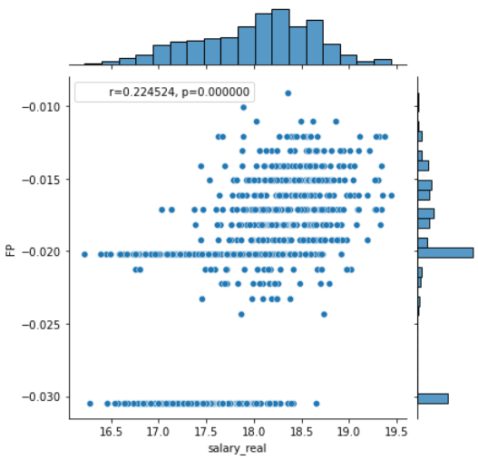
The Fielding % vs. Salary Linear Regression
Another interesting correlation
It would make sense for salary to correlate with pitching stats since pitchers tend to get the record-breaking salary contracts
However, this suggests salary broadly pays for good defensive players across the board

Slide 11
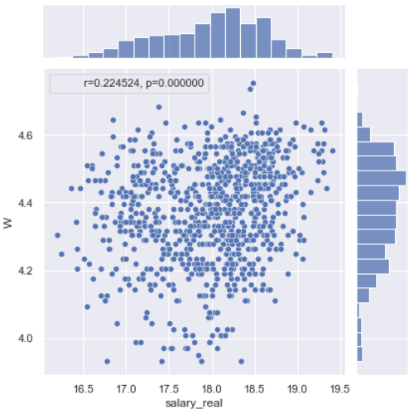
The Wins vs. Salary Linear Regression
This remarkably supports the chart from the first slide, but the sample size essentially drives the p-value to zero
The p-value pretty much rules out any chance of this observed data given there isn’t a relationship between wins and salary
But can it be as simple as spending money on payroll?

Slide 12
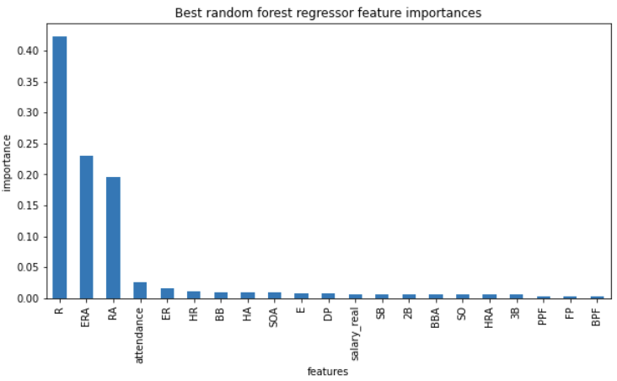
However, a Random Forest Wins Model
Random Forest (adj R2 = 0.81)
Contributors to wins dominated by runs, earned run average, and runs allowed
Salary is 12th in importance for modeling Wins
Not a compelling case for wins

Slide 13
But wait…
But wait – doesn’t salary pay for runs and pitching by paying more for the increased talent that delivers the runs and pitching?

Slide 14
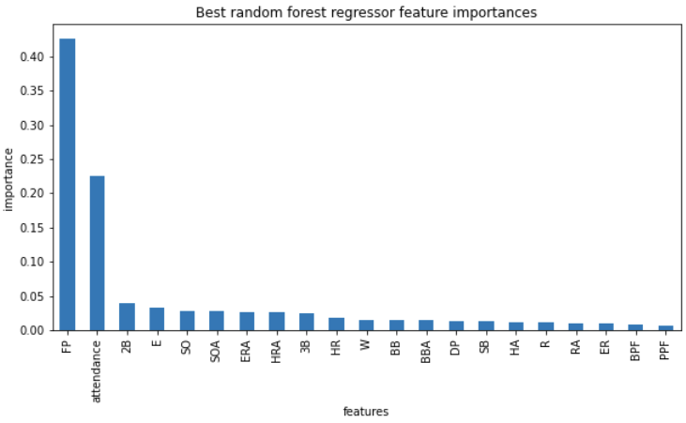
Salary mostly pays for fielding.
Random Forest (adj R2 = 0.66)
The two major contributors to salary is fielding percentage and attendance.
Wins is 11th in importance for modeling Salary
Also not a compelling case

Slide 15
Salary mostly pays for fielding.
The random forest models suggest that what explains the variation in payroll does not explain the variation in wins.
Attendance is interesting – a chicken or egg problem perhaps?
What explains wins?
What explains payroll?

Slide 16
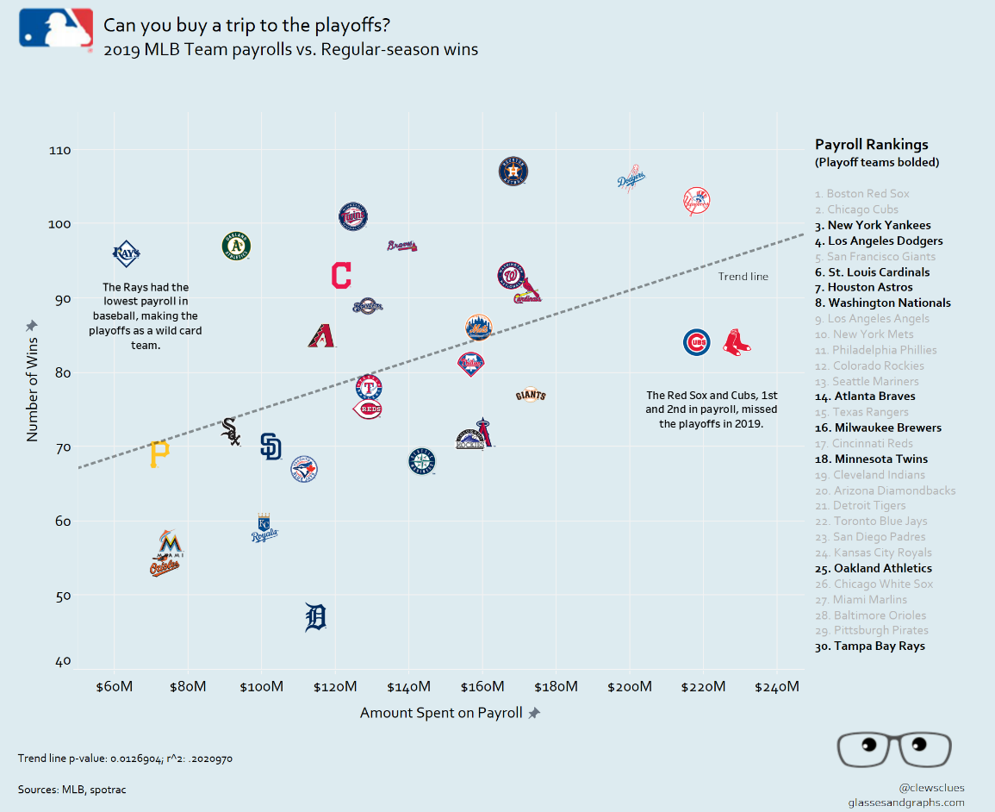
Conclusions: Rounding Third and Heading for Home
While there is clearly a relationship between wins and payroll, it neither rules out a #30 payroll team from making the playoffs or guarantees a #1 payroll team making the playoffs.
All-stars can be overpaid, and scrappy teams can have the x-factor of team chemistry

Slide 17
Conclusions: Rounding Third and Heading for Home
Regardless, higher payroll and the fielding percentage it allegedly brings probably doesn’t hurt
Underdogs are more fun to root for anyway (especially if they have a nonzero chance)

Slide 18
Recommendations
Pay for what you can afford, but pay for what contributes to wins first
If you’re lacking in offense, pay for offense before paying for an ace starter
If you’re above average in offence and don’t have an ace pitcher, splurge on a pitcher
Focus on developing team chemistry
With or without a massive payroll, this will set apart the great from the good

Slide 19
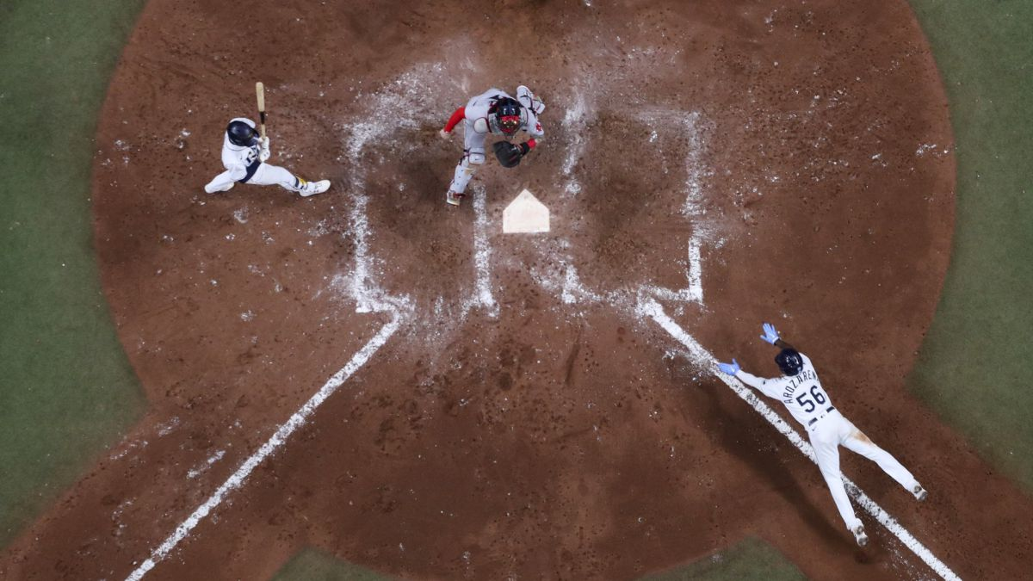
Data Limitations & Constraints
Data Limitations
Descriptive statistics are always a lagging indicator
While past performance is always a great indicator of future performance, players have bad seasons
It’s still in part a game of luck
Constraints
This only investigates wins in the regular season, a good indication of reaching the playoffs
It does not attempt to explain playoff performance or what it takes to win the World Series

Slide 20
Future Work: Sliding into Home
Future Considerations
Modeling making it to the postseason (a binary) instead of wins
Modeling winning the World Series (for fun)
Out of curiosity, further investigate the relationships to attendance

